Slide 1
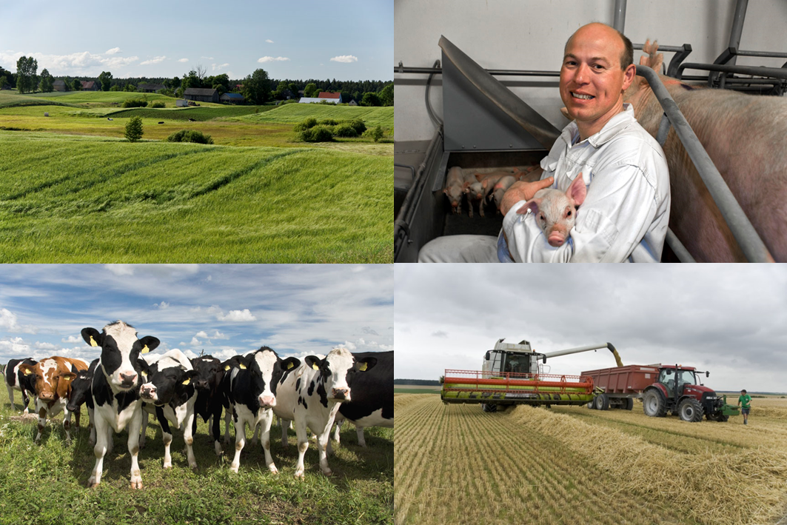
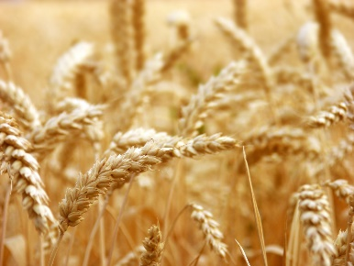
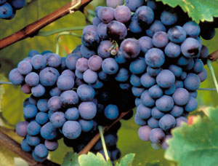
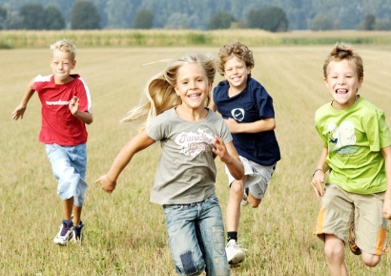
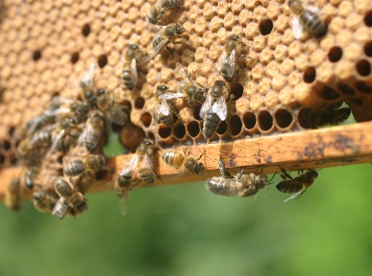
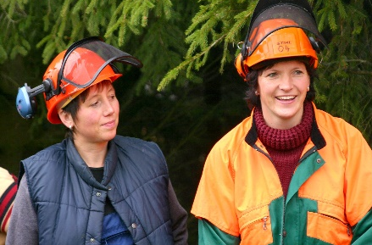

“The future CAP – Copa and Cogeca views”
DIS(17)6314:1 – PG/jg
Arnaud PETIT, Copa and Cogeca
18th October 2017

Slide 2
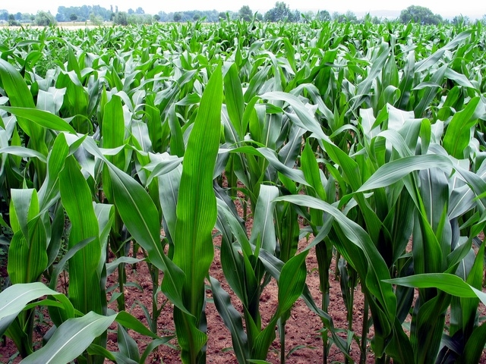
What are Copa and Cogeca ?
Copa – European farmers
Comprinsing 60 national farmers organisations from EU28
Cogeca – European agri Coops
Comprising 35 national platform of 22 000 coops

Slide 3
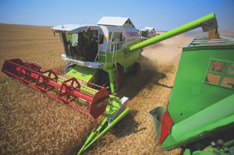
Main topics
Developments in the EU
The future CAP
Copa-Cogeca | The voice of European farmers and their cooperatives | 3

Slide 4
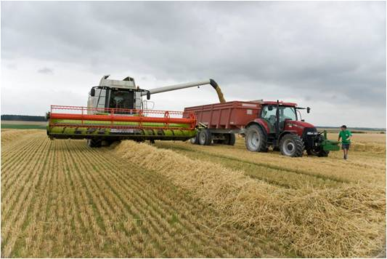
1. Developments in the EU
White paper on the future of Europe
Brexit, trade
The future MFF post 2020
Copa-Cogeca | The voice of European farmers and their cooperatives | 4
Notes:
White paper on the future of Europe
White Paper forms the Commission’s contribution to the Rome Summit of 25th March 2017.
During this Summit, Head of States will discuss EU achievements of the past 60 years but also its future at 27.
White Paper sets out five scenarios:
- Carrying on
- Nothing but the Single Market
- Those Who Want More Do More
- Doing Less More Efficiently
- Doing Much More Together
For time being, we can assume the 1st scenario would prevail
Brexit
The UK government triggered Art. 50 of the TEU on 29th March
The negotiations before the effective exit of the UK will take two years after the triggeringof Art.50
Throughout this process, Copa-Cogeca will liaise frequently with the Commission Art. 50 Task Force
Need to organise it in an orderly fashion, in the interest of all 28 Member States
European farmers, including those from the UK, are very much interested in continued cooperation, as they all have enjoyed the results of the mutual trade within the Single Market
Potential impact on agri-businesses is expected to be huge, UK being net importer of agri-food products and being well integrated into the Single Market
UK National Farmers Union have called for the best possible access to trade with Europe and access to a competent and reliable workforce
With the UK’s net contribution to the all EU budget reaching 10,3 billion euros annualy, Copa and Cogeca have serious concerns about the potential bugdet impact
Farmers and their cooperatives shouldn’t have to pay twice for the Brexit, from a budget and trade perspective

Slide 5

2. The future CAP
Objectives and Importance of a strong CAP
Main messages from Copa-Cogeca to ensure a Sustainable European Agriculture
Possible timeline for the future CAP
Copa-Cogeca | The voice of European farmers and their cooperatives | 5

Slide 6
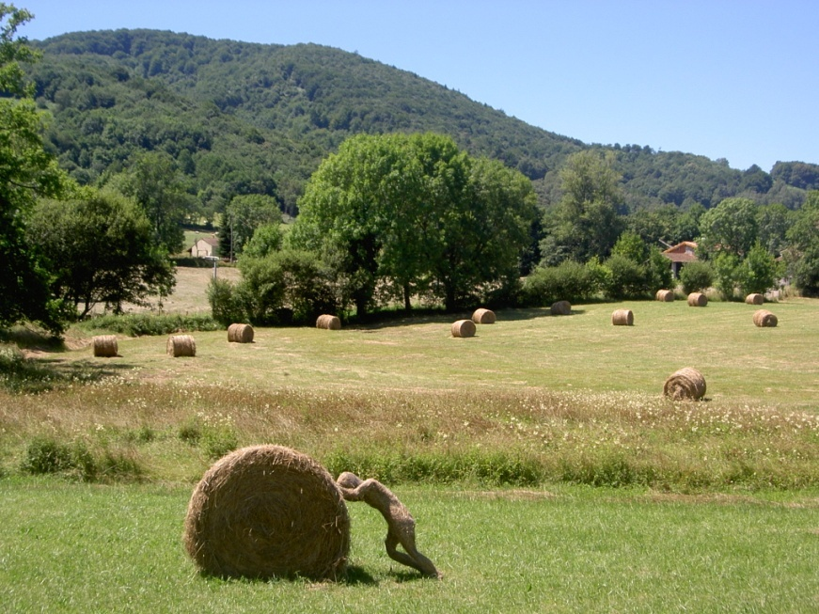
Objectives of the CAP
Maintain the CAP current objectives as per article 39(1) of TFEU.
CAP contributes to a stable rural environment and employment for the 40 million people working in the agri-food chain.
Positive contribution to growth & jobs and the Juncker Commission priorities (20 billion euros surplus in trade).
Support farmers for delivering public goods & services that cannot be remunerated by the market.
The CAP costs less than 1% of total public Spending.
Copa-Cogeca | The voice of European farmers and their cooperatives | 6
Notes:
Continue the market orientation of CAP.
Importance of a strong CAP
The EU must secure common funding for common policies.
CAP need adequate funding to deliver a strong, economically viable and competitive agriculture.
The CAP delivers for consumers and farmers alike.
CAP support must focus on active farmers – those who actively contribute to a sustainable sector and provide public goods.
The CAP costs less than 1% of total EU public Spending. This is good value for money to EU consumers.
The future CAP must focus on improving the current policy measures – it’s an evolution, not a revolution!
Both Pillars of the CAP are important and have specific objectives.
Pillar I delivers a common EU approach across all farms. It’s about sustainability, viable food production and food security.
Pillar II provides tailor made solutions at farm level. It supports investments and other public goods & services.

Slide 7
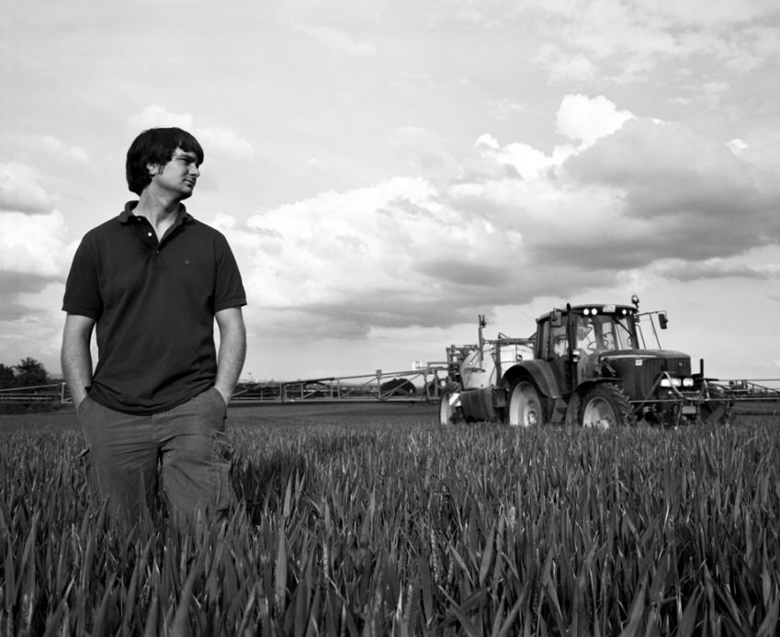
Main position of Copa –Cogeca to ensure a Sustainable European agriculture
Simplification;
Sustainability, climate change and SDGs;
Flexi-security for farm income to improve market resilience,
Coherent approach on risk management;
Strengthen farmers’ position in the food supply chain, supporting agri-cooperatives and Pos;
Investment support and improving infrastructures (EFSI)
Copa-Cogeca | The voice of European farmers and their cooperatives | 7

Slide 8
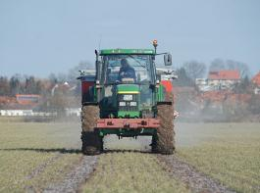
Main position of Copa –Cogeca to ensure a Sustainable European agriculture
Rural Development and Cork 2.0;
Generation renewal including access to land;
9. Strong promotion policy in a context of a long list of bilateral trade deal
Copa-Cogeca | The voice of European farmers and their cooperatives | 8

Slide 9
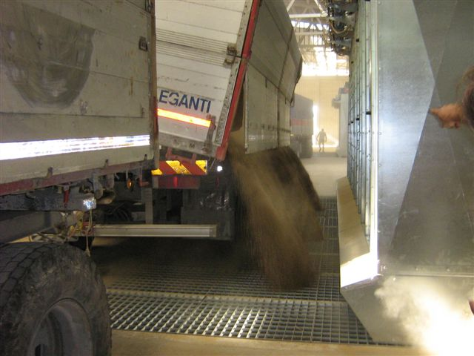
Possible Timeline for the future CAP
Communication on the future CAP: possibly end November 2017.
Legislative proposals on the future CAP: After MFF agreement.
Brexit: Article 50 activated on 29th March; Exit by April 2019 (???)
European elections: May 2019.
New European Commission: Nov./Dec. 2019
Conclusion of the negotiations on the future CAP: ???
Copa-Cogeca | The voice of European farmers and their cooperatives | 9

